Slide 1
Enriching Numeracy Learning in the British Columbia Curriculum Through Engaging with the Ktunaxa Origin Story and Land-Based Pedagogy
Anneli Schadeli
Notes:
kiʔsuʔk kyukyit (Key suek que key it ) Good Afternoon! My name is Anneli Schadeli and I am happy to share my final creative project Enriching Numeracy Learning in the British Columbia Curriculum through engaging with the Ktunaxa Origin Story and Land-Based Pedagogy.
https://www.firstvoices.com/explore/FV/Workspaces/Data/Ktunaxa/Ktunaxa/Ktunaxa/learn/phrases/430f92ee-a8d1-4aca-824c-5b0cf49e53fb

Slide 2
I am of Swiss and Danish ancestry living on the homelands of the Ktunaxa people. Ktunaxa knowledge and perspectives are foundational to education. As an educator, I aim to deepen my understanding and share this with my students.
Notes:
Situating myself

Slide 3
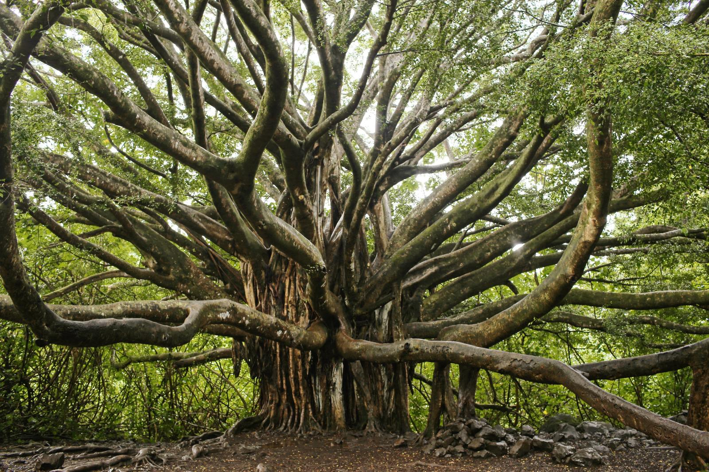
"Mother Tree" (Weeden & One Tree Planted, 2020)
Notes:
At the beginning of my master's program, I watched a TED Talk by Suzanne Simmards about Mother trees, which profoundly impacted me (Simard, 2016).
This talk revealed the interconnectedness of trees, plants and fungi, how they communicate and support each other and the reliance this system has on a strong mother or hub tree. As an educator wanting to guide my students, this urged me to consider how to deepen my teaching to better support students' holistic well-being.

Slide 4
First Peoples Principles of Learning
Learning ultimately supports the well-being of the self, the family, the community, the land, the spirits, and the ancestors.
Learning is holistic, reflexive, reflective, experiential, and relational (focused on connectedness, on reciprocal relationships, and a sense of place).
Notes:
First Peoples Principles of Learning describes a set of learning principles specific to First Peoples. These principles were developed by Indigenous Elders, scholars and knowledge keepers in BC. to guide the development of the curriculum and teaching.
One goal was of this project was to incorporate the first peoples principles of learning into the numeracy activities.
Jody Wilson-Raybould in her book, True Reconciliation (2022) states, “True reconciliation is a marathon, not a sprint.”

Slide 5
Land-Based Pedagogy
Revolves around Indigenous people’s deep connection to Land as a living being.
Land is our first teacher, and as it is our Elder relation, we must learn from Land, with Land, and situate our learning on Land (Styres et al., 2013).
Notes:
Land-Based Pedagogy in this project was essential because it ties into the first people’s principles and throughout this masters program, I have realized how important it is for us to shift our mindset. We are not the masters of Land, we are here to learn from Land, and my goal through this project was to encourage this as much as possible. When we would go out, I would ask, What will the trees teach us today?” We were not just
As Land is a living being, it will be referred to as using its name, Land.
“A pedagogy of land also refers to the spiritual, emotional and intellectual aspects of Land” (Styres et al., 2013).
In land-based pedagogies, there is an understanding that place exists on Land.
Styres et al. (2013) and Stewart (2004) suggest that humans are not more important than Land or ‘masters’ of Land.

Slide 6
Numeracy
Numeracy Cycle
“Numeracy is the ability, willingness, and perseverance to interpret and apply mathematical understanding to solve problems in contextualized situations and to analyze and communicate these solutions in ways relevant to the given context” (Government of British Columbia, 2017).
Notes:
A numerate student can use their skills, resources, and creativity, along with mathematical concepts and tools, to answer questions, solve problems, and make sense of their daily experiences.
Focus is on application of mathematic concepts to real-life questions.
One of the reasons that our focus was on numeracy is that the BC Ministry of education is currently reworking the numeracy curriculum to make it clear that numeracy should not just be a focus in math but throughout all subjects. The second reason was due to declining numeracy scores on Foundational Tests and Graduation Numeracy exams. The final goal is to increase numeracy scores and student engagement. Basing numeracy activities within real-life cultural contexts offers an opportunity for increased student engagement, and with increased engagement comes the possibility of increased numeracy scores.
Numeracy Cycle - When students are engaged in numeracy practice, they should work to understand the context (situation, idea, or problem), decide how to go about addressing it, determine what mathematics can be used, and decide if their solutions (answers or decisions) make sense to the context. The numeracy cycle identifies the five numeracy processes students may draw upon.

Slide 7
Ktunaxa Creation Story as told by Nasuʔkin Joe Pierre
Notes:
Nasuʔkin Joe Pierre telling the Ktunaxa Creation Story helped me see that land-based pedagogy, first people’s perspectives and numeracy could work together to achieve a more meaningful learning experience for students.

Slide 8
The Team
Ami Barras
Bryan Faucher
Faye O’Neil
Janine Wittig
Jennifer Doll
Kathy Conlin
Ryan Mckenzie
Tara Elliot
Notes:
I want to acknowledge as I worked through this project, I found a group of other educators that wanted to Link the Ktunaxa Creation story to Numeracy. Thank you to Kathy Conlin, our SD5 district Numeracy teacher, this would not have been possible without her accessing grants and district funds to find time for us to meet and collaborate.

Slide 9
Water Speed
How fast was the water moving that Yawuʔnik̓ swam through?

Slide 10
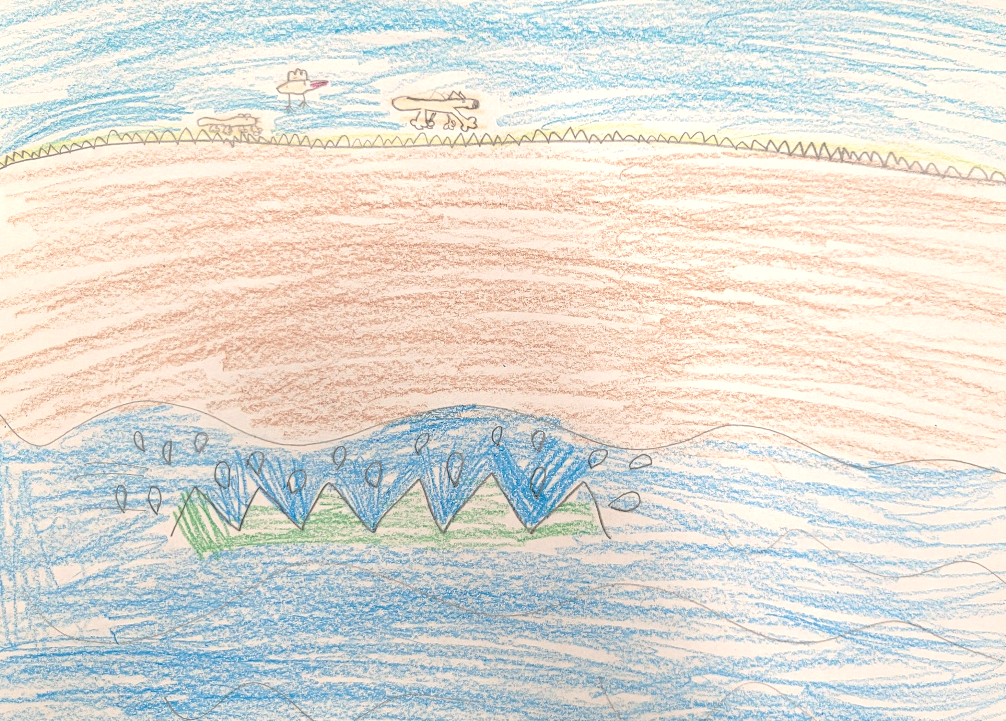
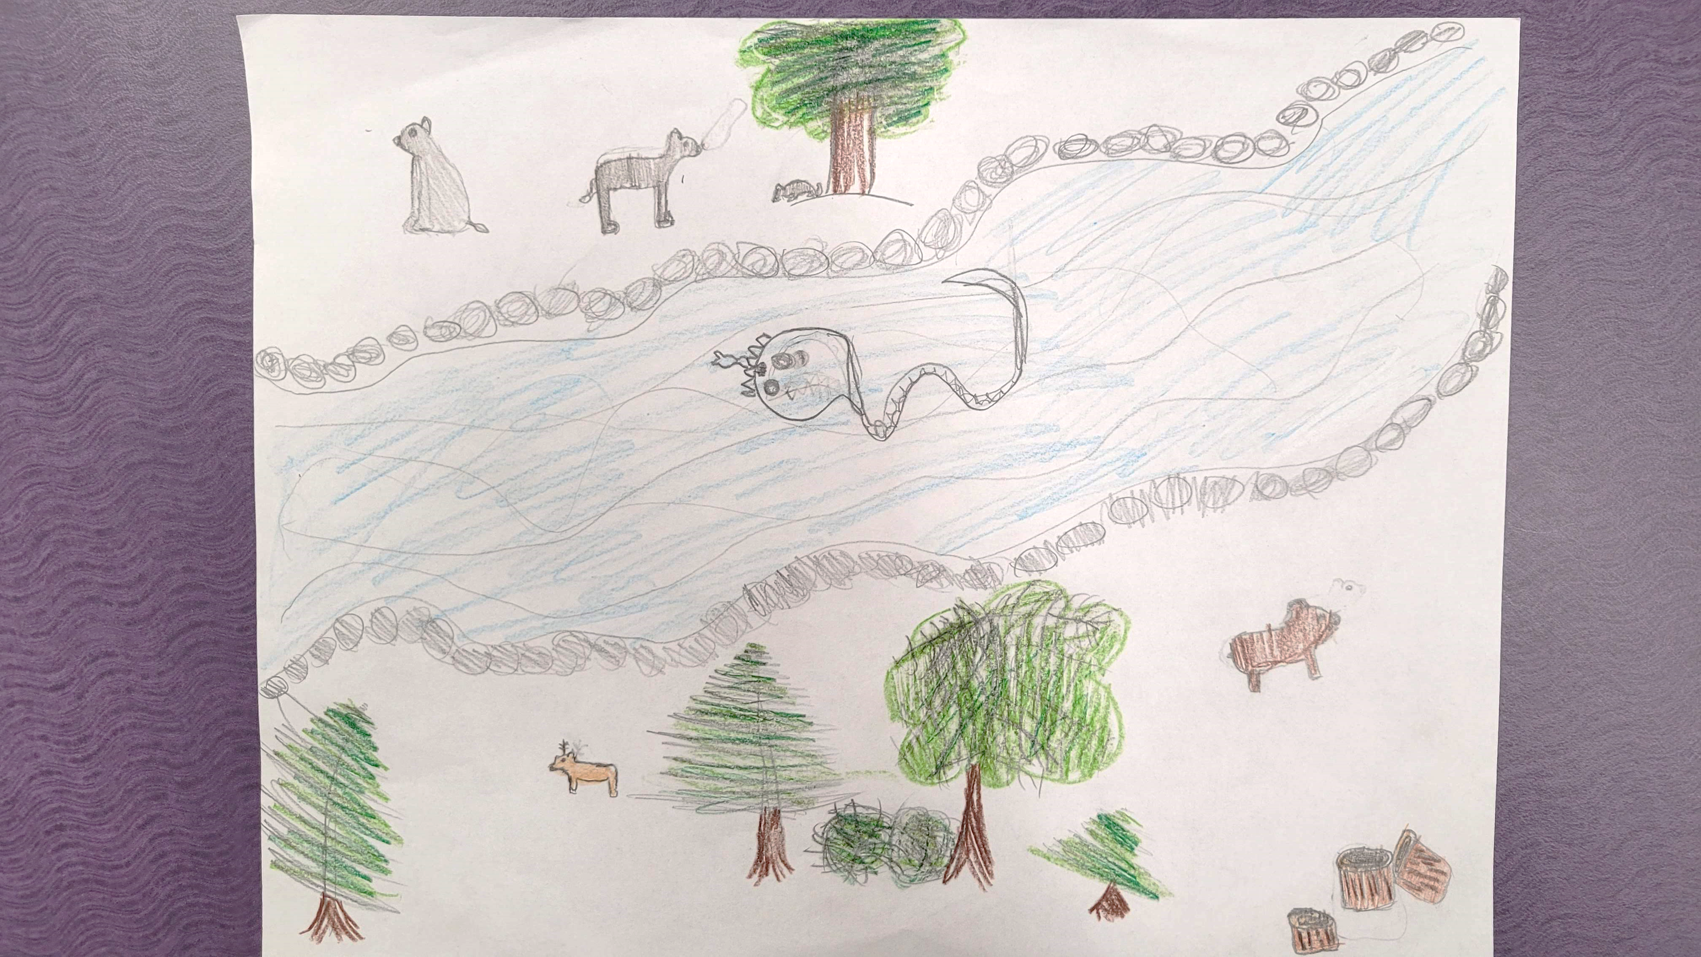

Slide 11
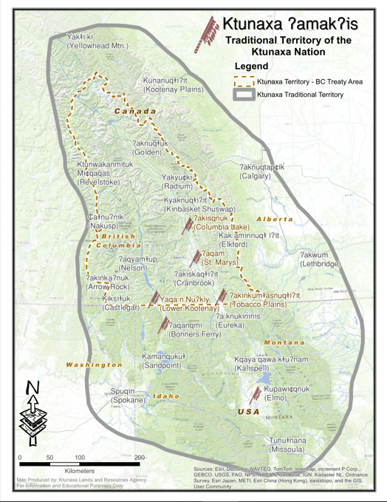
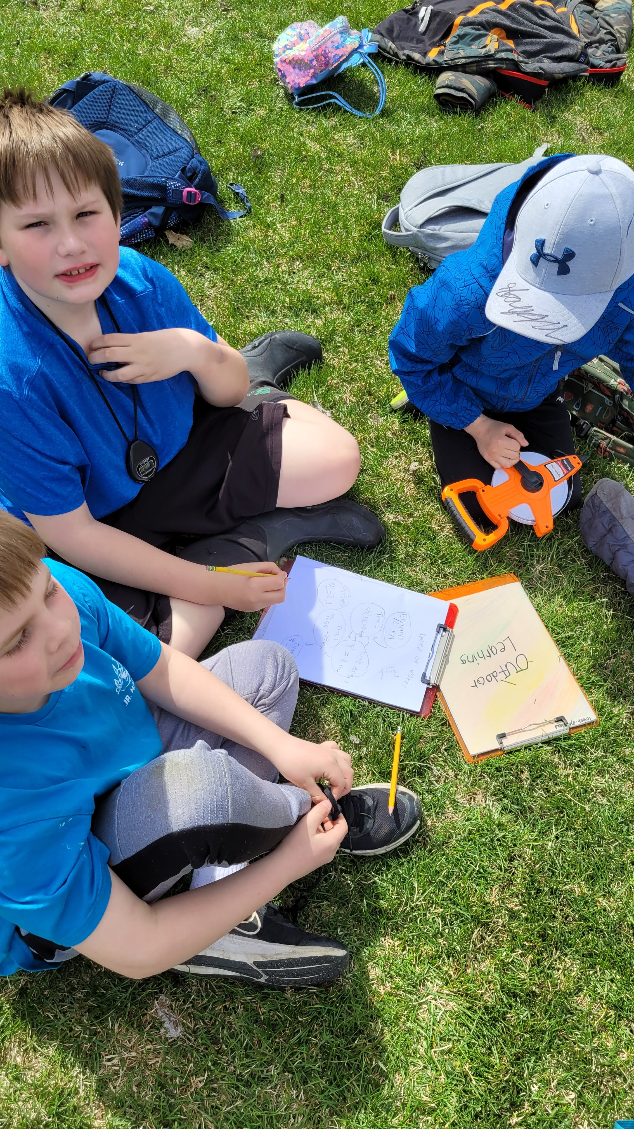
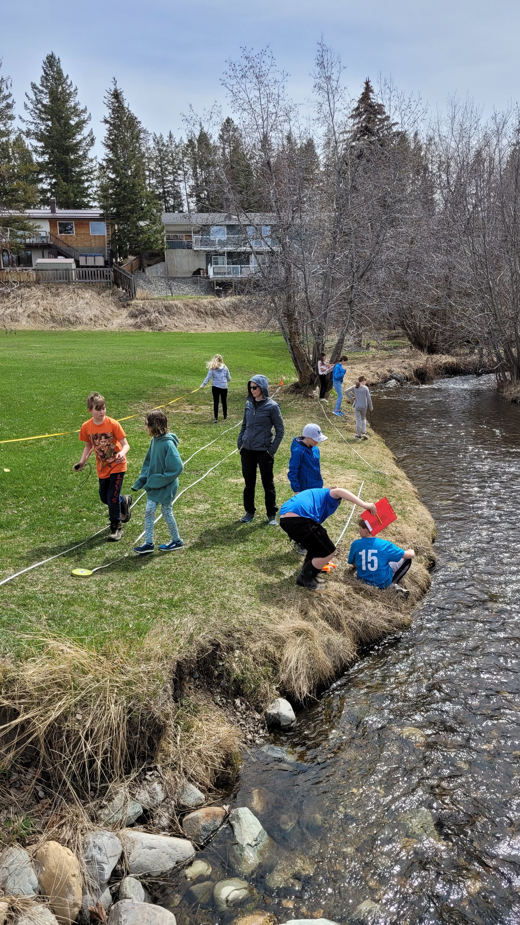
Notes:
Talk about Lessons
Discuss how students are learning about land and numeracy at the same time in these pictures.

Slide 12
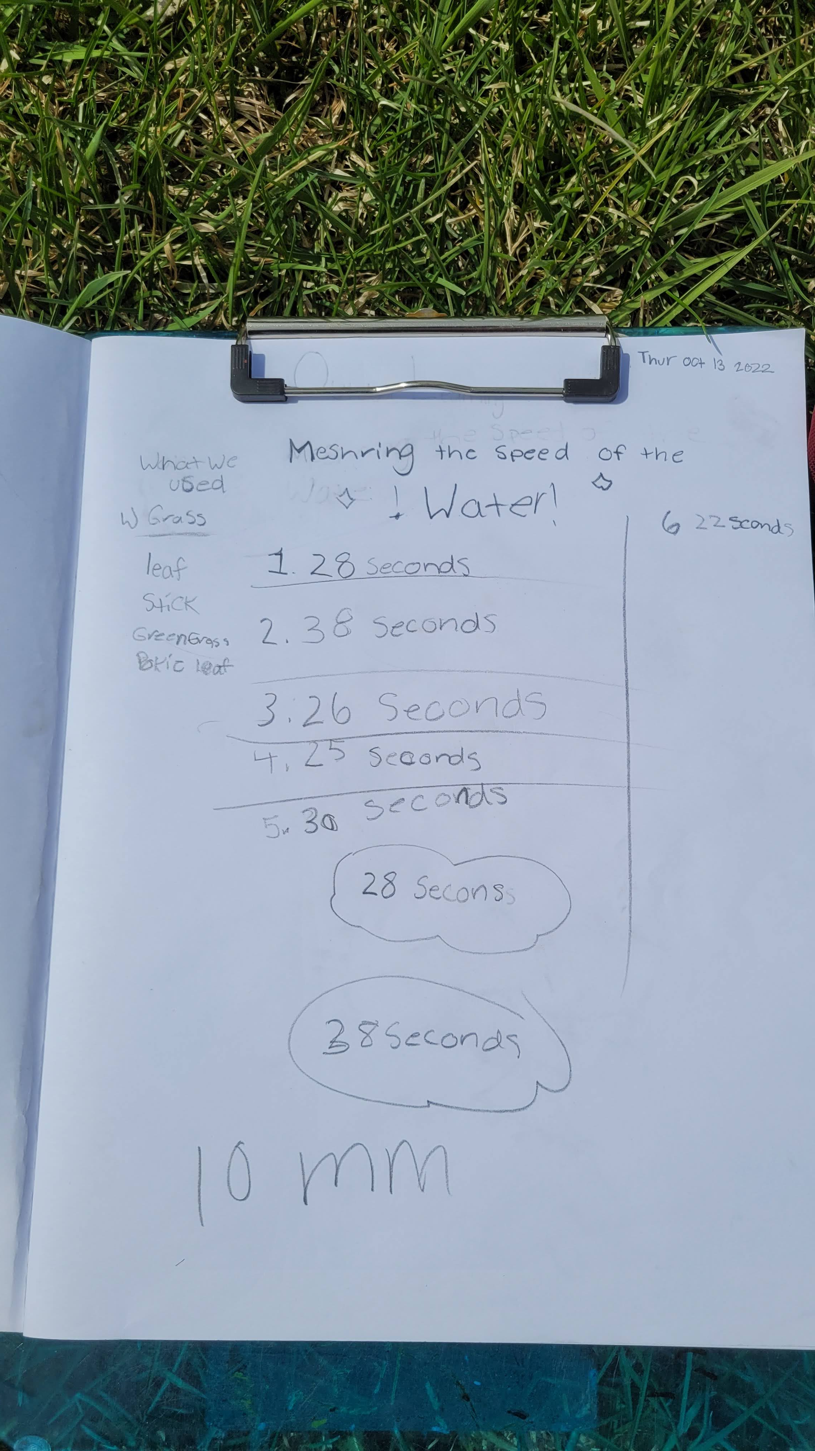
Notes:
Discuss how students are learning about the land and math at the same time in these pictures.

Slide 13
Trees and Seventh Generational Thinking
How do we decide which trees to keep?
Notes:
This is also found within land-based pedagogies. Learning from Land, listening to the stories it tells us of its past and understanding seventh generational thinking, which “suggests each generation is responsible for ensuring that decisions are made with a view to the implications seven generations into the future” (Styres et al., 2013)
Quote of Reciprocity from Braiding Sweetgrass – Our first responsibility for the gift is gratitude, then the second is reciprocity: to give a gift in return. What if we thought that everything we consume is a gift from Mother Earth?
I think that we would take better care of what we are given. How we think influences how we act and how we act has an impact. I was taught to reciprocate berries with a gift of my own. It might be that I scatter their seeds or plant the little ones back in the ground so they would continue to provide berries.

Slide 14
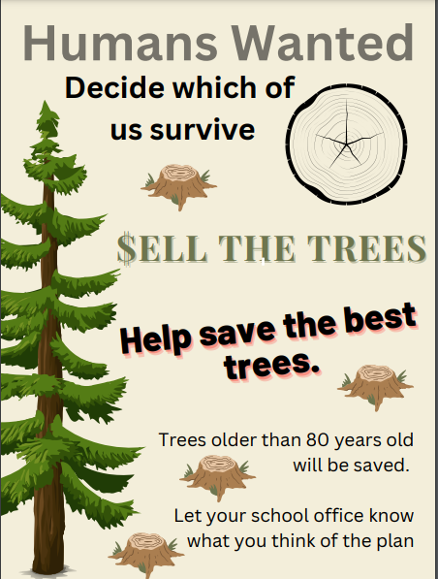
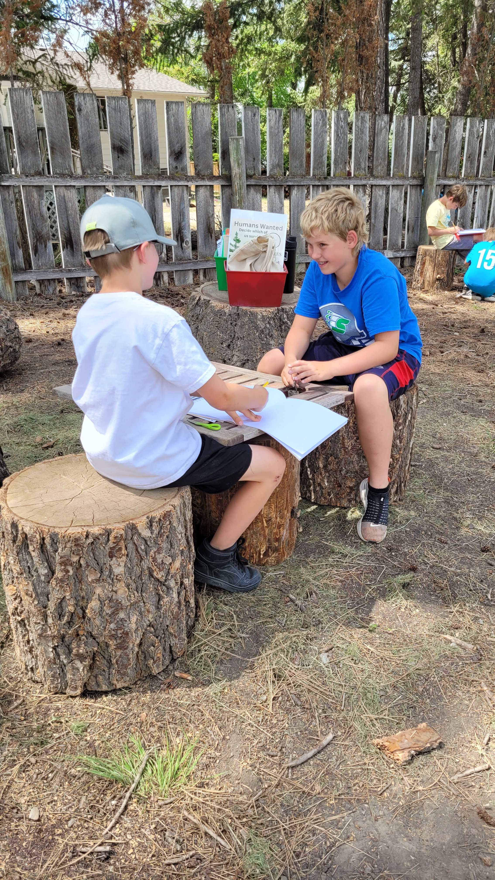
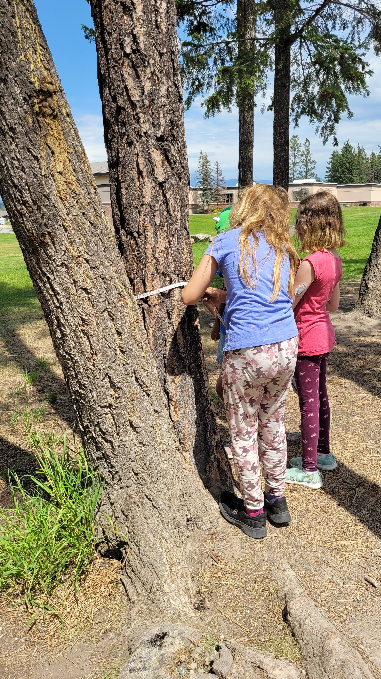
Notes:
We had been talking about how important trees were to our school and they were really upset when they saw a poster talking about cutting down trees. This upset some of them and when we reviewed the Ktunaxa creation story, we talked about reciprocity, how the trees were willing to give us their bodies for tools, homes, fibre if we sang their songs, and spoke up for them.
When we talked about the relationship between age and perimeter (circumference), one student added that it didn’t work perfectly because some years, the tree grew more than others if they got more nutrients.

Slide 15
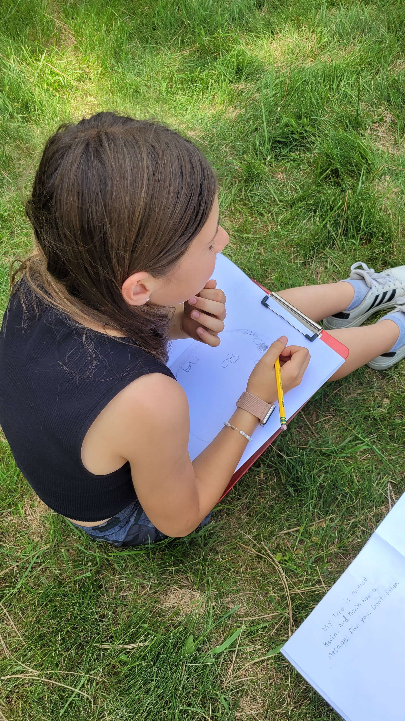
Notes:
We had been talking about how important trees were to our school and they were really upset when they saw a poster talking about cutting down trees. This upset some of them and when we reviewed the Ktunaxa creation story, we talked about reciprocity, how the trees were willing to give us their bodies for tools, homes, fibre if we sang their songs, and spoke up for them.
When we talked about the relationship between age and perimeter (circumference), one student added that it didn’t work perfectly because some years, the tree grew more than others if they got more nutrients.

Slide 16
Catching the Yawuʔnik̓
What other ways could you trap the Yawuʔnik̓?

Slide 17
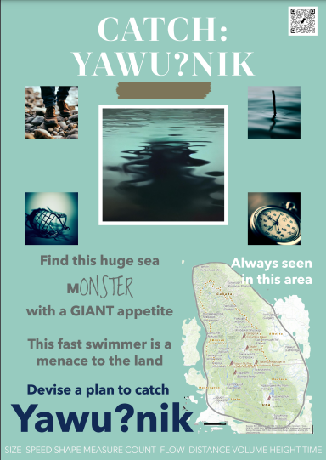
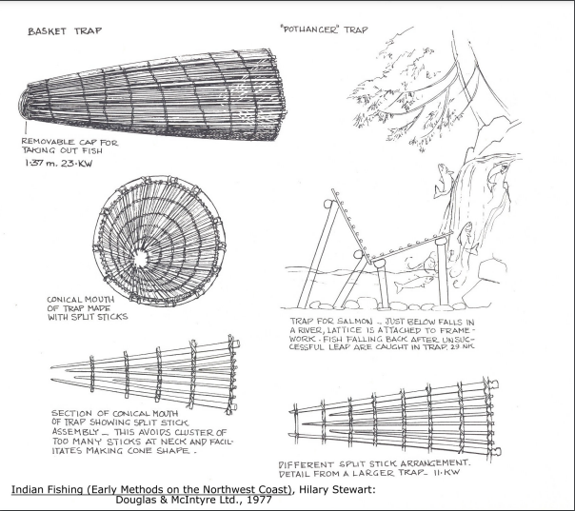

Slide 18
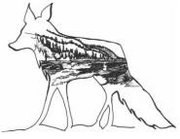
Successes and Challenges
Increased student engagement in numeracy
Deeper understanding of the interconnectedness with our non-human relations
Relationships I built with other educators and Ktunaxa leaders
Increased confidence in incorporating Ktunaxa knowledge
Hard to change to a language of animacy
Want to foster more connections with the Ktunaxa community and my students
Notes:
Fox Nak̓yu

Slide 19
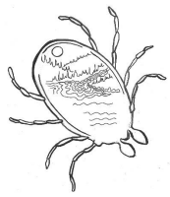
Thank you Hu sukiⱡq̓ukni
Anneli Schadeli
cpb20cbu@cbu.ca
(O’Neil & Gravelle, 2022)
Notes:
Woodtick Cam̓na

Slide 20
Links to Numeracy Activities and Other Resources
Activity 1: Speed of Water
Activity 2: Trees and Seventh-Generation Thinking
Activity 3: Catching the Yawuʔnik
First Peoples Principles of Learning
Growing Innovations in Rural Sites of Learning Grant
Ktunaxa Core Competencies and Ktunaxa First Voices

Slide 21
References
CKFPC - Central Kootenay Food Policy Council. (2021, November 2). Ktunaxa Creation Story - Told by Nasuʔkin Joe Pierre [Video]. YouTube. https://www.youtube.com/watch?v=WnMXwq58Q5I
Government of British Columbia. (2017). Graduation Numeracy Assessment: Design Specifications – Sept 2017.
O’Neil, F., & Gravelle, E. (2022, February 10). Core Competencies Working Document.
Province of British Columbia. (2023). Building Student Success - B.C. Curriculum. Retrieved June 3, 2023, from https://curriculum.gov.bc.ca/curriculum/mathematics
Styres, S., Haig-Brown, C., & Blimkie, M. (2013). Towards a Pedagogy of Land: The Urban Context. Canadian Journal of Education, 36(2), 34–67.
Weeden, M. & One Tree Planted. (2020). [Mother Tree]. One Tree Planted. https://onetreeplanted.org/blogs/stories/mother-trees-mothers-day?_pos=1&_sid=c6e27dd24&_ss=r

